Slide 1


Valley Gang Prevention
Hemet/San Jacinto Valley Chamber of Commerce

Slide 2


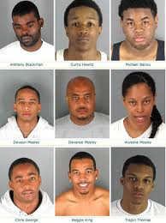
The Problem
Last summer the City of Hemet experienced two black gang related homicides with multiple shootings. Witnesses were unwilling to cooperate with police to solve the case.

Slide 3

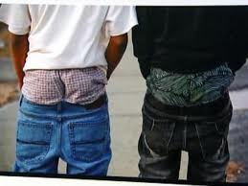
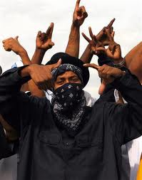

The Growing Problem

Slide 4
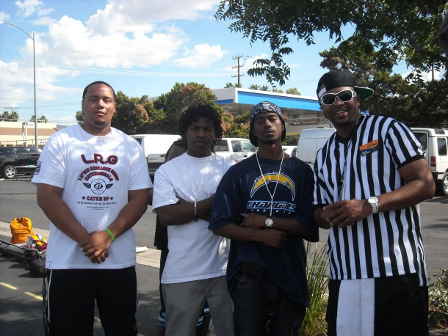
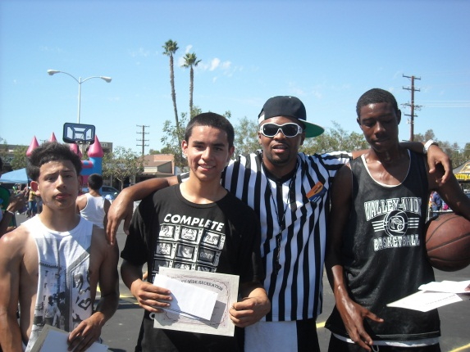
The Motivation
Concern from local citizens and business owners motivated the Chamber of Commerce to address the social development of our growing black youth population. It was determined that we can attack gangs at their root by educating and protecting our school-age children.

Slide 5
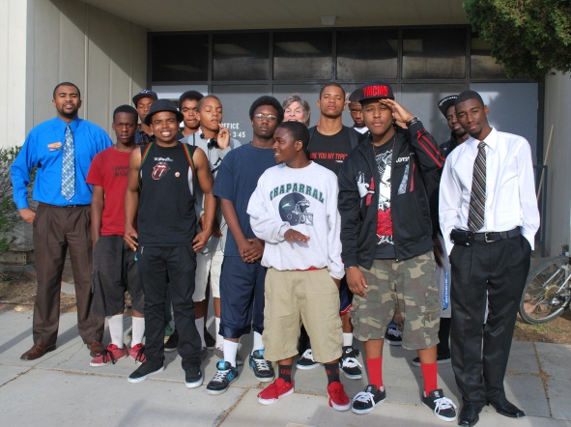
Valley Gang Prevention School
Our school is located at
136 N. Ramona St.
Hemet, California
(the old H.E.L.P. school site)
Currently we are training 20 African American students; who will become Peer Leaders for our
Hip-Hop Business League.

Slide 6
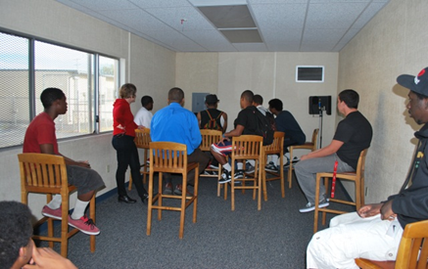
The Tools
Professionalism - Professional skills is the only cure for the growth of gang culture.
Sales – Regardless of the fluctuating economy, commission sales positions are constant.
New Media - Audio/video recording,
social media marketing,
graphics design, and web
development are skills
that are in growing
demand.

Slide 7

The Result
Music Demo Tape Vol. 1 - Our first Hip-Hop Business League project is slated to be released this summer. All music from this project is written and recorded by the students and is considered to be educational and family-friendly. The project is strategic in nature to educate, encourage positive behavior and serve as a fundraising tool as we continue to seek program sponsorship.

Slide 8

Valley Gang Prevention
Hemet/San Jacinto Valley Chamber of Commerce

