Slide 1
Housing Element Update 2021-2029
City Council/Planning Commission Study Session – November 10, 2021

Slide 2
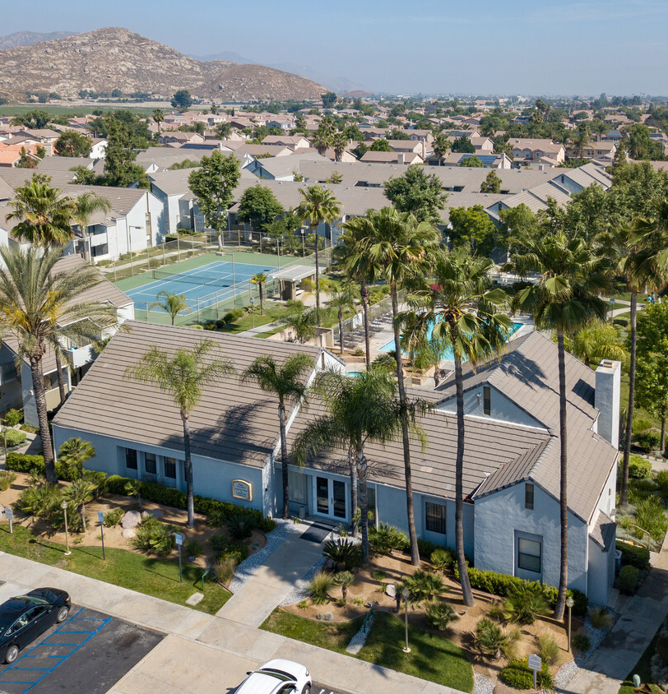
Agenda
Housing Element Update Background
Community Engagement
Candidate Housing Sites and Strategy
Goals, Policies, and Programs
Next Steps

Slide 3
Housing Element Update Background

Slide 4
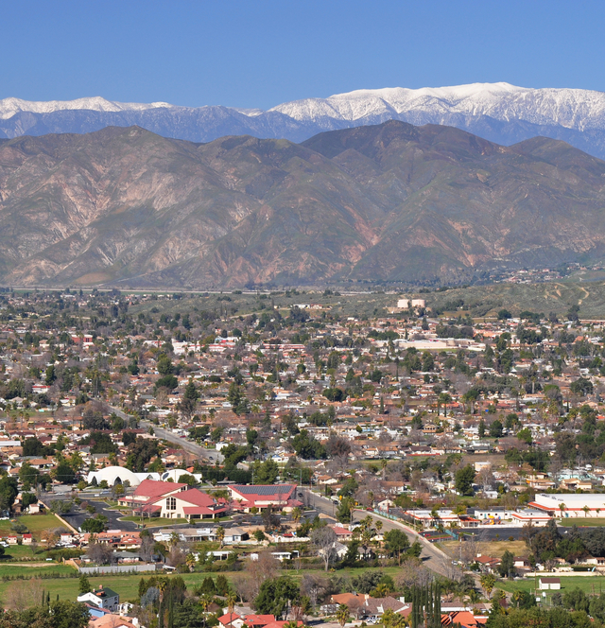
Why are Housing Elements Updated?
State law requires the Housing Element to be updated every 8 years
Engages Hemet residents and stakeholders in the planning process
Demonstrates Hemet’s ability to meet current and future housing needs
Establishes policies and programs to address the housing needs of Hemet’s residents
Certified by the Department of Housing and Community Development (HCD) to ensure the compliance with state housing laws

Slide 5
New Legislation for Housing Elements
Funding Measures:
SB 2
SB 3
Streamlining Measures:
SB 35
SB 540
AB 73
AB 2753
SB 765
SB 330
AB 1485
SB 744
Accountability Measures:
AB 167
AB 678
AB 1515
ADU Measures:
AB 68
AB 881
SB 13
AB 587
AB 670
AB 671
Other Measures:
AB 1505
AB 879
AB 1397
AB 72
AB 2372
SB 1227
AB 2797
AB 3194
SB 765
And more

Slide 6
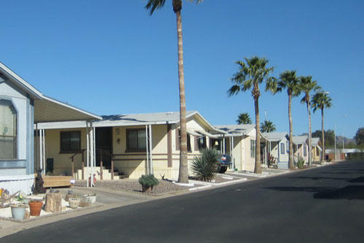
Affirmatively Furthering Fair Housing
Fair and equitable distribution of housing throughout the community
Protects against communities being overburdened
Takes into consideration:
A variety of housing types (single-family house, apartment, townhome, etc.)
Mix of affordability levels
Access to transportation and employment
Considers access to public transit and community resources

Slide 7
Housing Element Components
Section 1 - Introduction
Section 2 - Population and housing profile
Section 3 - Evaluation of housing constraints, resources, and affirmatively furthering fair housing
Section 4 - Policies, programs, and quantified objectives to achieve the City’s identified housing goals
Appendix A - Evaluation of current programs and policies
Appendix B - Analysis and identification of sites to accommodate the City’s RHNA allocation
Appendix C - Community Outreach Summary
Appendix D - Glossary of Housing Terms

Slide 8
Community Engagement

Slide 9

Community Engagement To-Date
Virtual Community Workshops
Workshop #1 - April 29, 2021
Workshop #2 – October 7, 2021
Outreach to community stakeholders
Joint Study Session with City Council and Planning Commission (June 19, 2021)
Public Review Draft and Feedback Form (September 24 – October 24, 2021)
Website with Public Review Draft, background information, and engagement opportunities

Slide 10
Candidate Housing Sites and Strategies

Slide 11
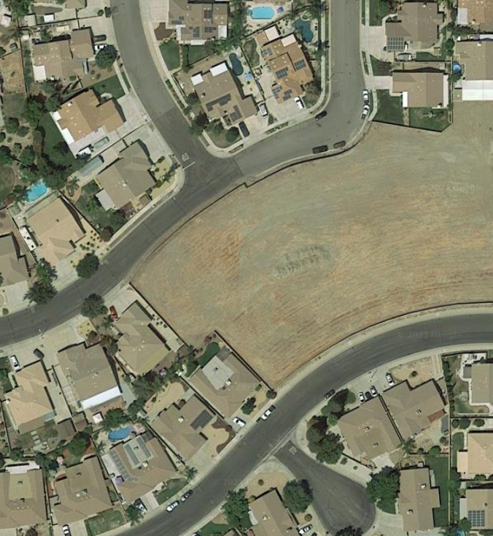
Candidate Sites Strategy
The Housing Element identifies candidate sites to accommodate the City’s 2021-2029 RHNA growth need.
The proposed candidate sites are focused in areas of the City with existing infrastructure, resources and transportation.
Strategy:
Projected development of Accessory Dwelling Units (ADU)
Existing vacant residentially zoned properties
Buffer for sites that may develop with less units

Slide 12
Candidate Sites Identified
 | Very Low Income | Low Income | Moderate Income | Above Moderate Income | Total
RHNA (2021-2029) | 812 | 732 | 1,174 | 3,748 | 6,466
Current Projects (In-the-Pipeline Projects) | 900 units |  | 0 units | 4,042 units | 4,942 units
Sites Available to Accommodate RHNA
Existing, Vacant Residentially Zoned Properties | 761 units |  | 1,350 units | 1,676 units | 3,787 units
Accessory Dwelling Unit Projections | 51 units |  | 30 units | 7 units | 88 units
Total Potential Development Capacity | 1,712 units |  | 1,380 units | 5,725 units | 8,817 units
Sites Surplus/Shortfall (%) | +11% |  | +18% | +53% | -
Sites Surplus/Shortfall (#) | +168 units |  | +206 units | +1,977 units | +2,351 units

Slide 13
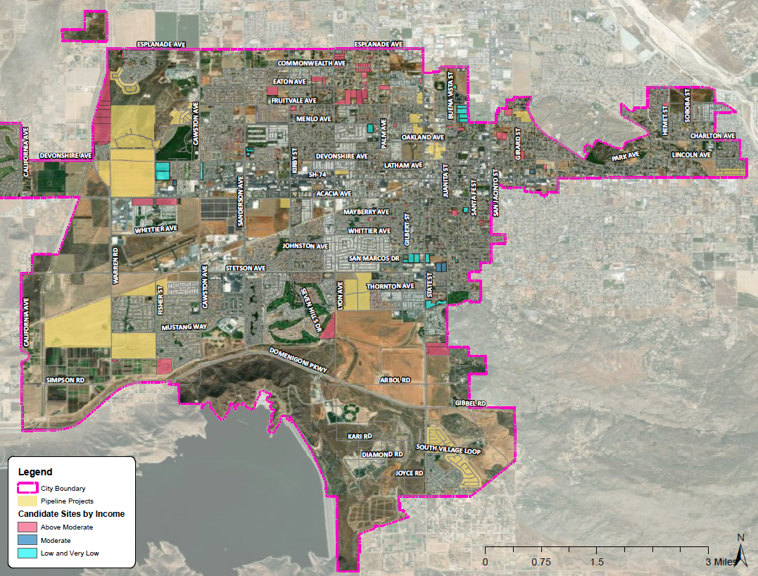
Location of Housing Sites

Slide 14
Goals, Policies, and Programs

Slide 15
Overall Housing Goals
Housing Goal #1: Provide for the attainment of quality housing within a satisfying living environment for households of all socio-economic, age, and ethnic types in Hemet.
Housing Goal #2: Facilitate the provision and improvement of affordable housing to meet the needs of the community.
Housing Goal #3: Provide adequate sites for housing.
Housing Goal #4: Preserve existing neighborhoods and rehabilitate the existing housing stock.
Housing Goal #5: Preserve affordable housing opportunities.

Slide 16

New 2021-2029 Policy Program Topics
Promotion of Accessory Dwelling Unit (ADU) and Junior Accessory Dwelling Unit (JADU) Development
Objective Development Standards
SB 35 Streamlining
Emergency Shelters, Transitional and Supportive Housing, and Lower Barrier Navigation Centers
Housing for Persons with Developmental Disabilities

Slide 17
New 2021-2029 Policy Program Topics
Farmworker Housing
Funding and Rental Assistance Programs
Preserve and Monitor At-Risk Units
Mobile Home Park Preservation
Housing Voucher Program
Density Bonus
Remove Development Constraints
Fair Housing

Slide 18
Example Policy Program
Program H-3a: Compliance with Regional Housing Needs Allocation
The City has a sufficient inventory of available sites to ensure capacity to accommodate the City’s 2021-2029 RHNA allocation. This includes existing zoning for sites which are adequate to accommodate the City’s allocation of 406 units affordable to extremely low-income households, 406 units affordable to very-low-income households, 732 units affordable to low-income households, 1,174 units affordable to moderate income households, and 3,748 units affordable to above-moderate income households. The City will continue to monitor development of current projects to meet its RHNA allocation.
Timing: 2021 – 2029
Responsible Agency: Community Development Department, Planning Division; Community Investment Department; City of Hemet Housing Authority
Funding Source: General Fund

Slide 19
Next Steps

Slide 20
Next Steps
HCD First Draft Submittal October 27, 2021
City Adoption of Housing Element
Submit Adopted Housing Element to HCD for Certification
60-Day HCD Review Period
Through December 2021
Revise Housing Element Following HCD Feedback
Safety Element and Environmental Justice Element Updates:
Upcoming Community Workshop: January/February 2022
(Workshop date will be posted to the City’s website when scheduled)

Slide 21
Thank you!
Monique Alaniz-Flejter, Principal Planner
Email: mflejter@hemetca.gov
Phone: (951) 765-2370
Housing Element Update Webpage:
www.hemetca.gov/1029/Housing-Element-Update

