Slide 1
Housing Element Update 2021-2029
City Council/Planning Commission Study Session – June 29, 2021

Slide 2
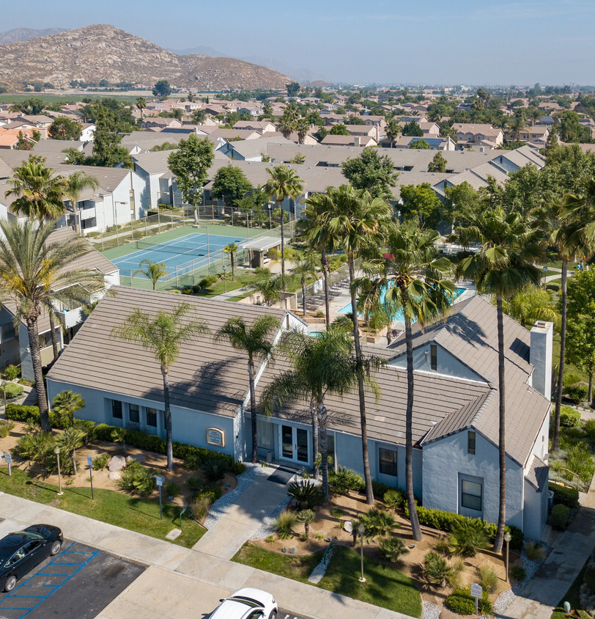
Agenda
Updates to the General Plan Elements
Summary of Housing Element Update Process
Community Engagement
Community Profile
Sites Inventory Analysis
Next Steps

Slide 3
Updates to General Plan Elements

Slide 4
Updates to General Plan Elements
Housing Element (Update) | Safety Element (Update) | Environmental Justice Element (New Element)
The Housing Element Plans for the current and future needs of housing in Hemet. It examines the unique needs of the community and sets policies and programs. | The Safety Element plans for all potential emergency events to minimize risk of injury, loss/ damage of property, and environmental damage from natural and man-made hazards. This update will include a review of the Fire/Wildfire section(s) and the addition of a Climate Change section. | The Environmental Justice Element addresses health risks in disadvantaged communities through decreasing pollution exposure, increasing community assets, and improving overall health. This is a new Element to the General Plan as required by Senate Bill 1000.

Slide 5
Summary of Housing Element Update Process

Slide 6
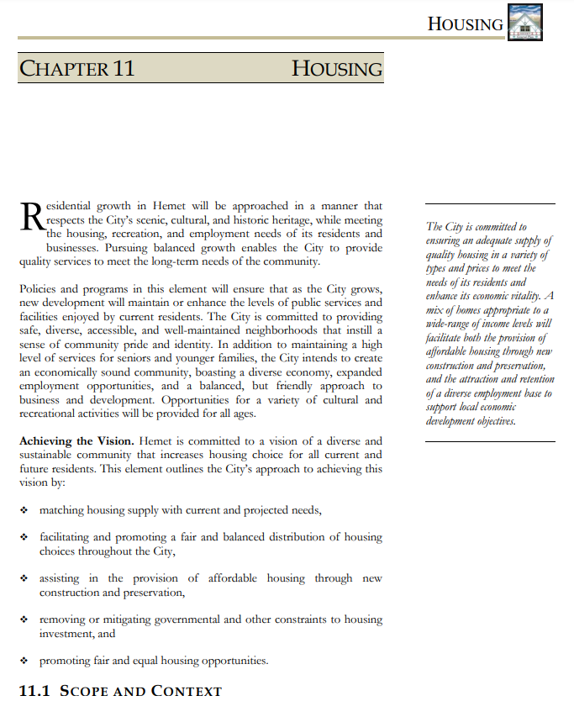
Housing Element Background
Required element of the City’s General Plan
Requires adoption by the State Department of Housing and Community Development (HCD)
Updated on 8-year cycles
Requires a General Plan Amendment and at least one public hearing by Planning Commission and City Council
Statutory deadline - October 15, 2021
120-day grace period beyond October 15

Slide 7
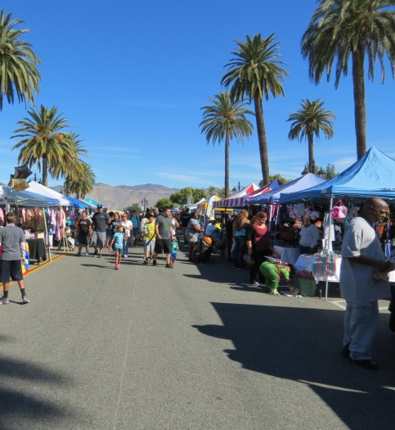
Housing Element Components
Population and housing profile
Evaluation of housing constraints and resources
Evaluation of current programs and policies
Analysis and identification of sites to accommodate the City’s RHNA allocation
Policies, programs, and quantified objectives to achieve the City’s identified housing goals

Slide 8
2021-2029 Hemet RHNA Allocation
Income Category | % of Area Median Income (AMI) | Income Range¹ |  | RHNA Allocation (Housing Units)
 |  | Minimum | Maximum
Very Low Income | 0 - 50% AMI | -- | $38,750 | 812 units
Low Income | 51 – 80% AMI | $38,751 | $62,000 | 732 units
Moderate Income | 81 – 120% AMI | $62,001 | $93,000 | 1,174 units
Above Moderate Income | >120% AMI | $93,001 | -- | 3,748 units
TOTAL: |  |  |  | 6,466 units
1. Income range is based on the 2021 HUD Area Median Income (AMI) for Riverside County of $77,500 for a family of 4.

Slide 9
Housing Element Certification
What Does it Mean to Have a “Certified” Housing Element?
Benefits of Certification
Reviewed for compliance with state law by the Department of Housing and Community Development (HCD)
“Certification” demonstrates substantial compliance with state law
Access to state-sponsored grants and alternative funding sources
Protects the City from state penalties and fines due to non-compliance

Slide 10
Certification Non-Compliance
Non-compliance risks:
Potential loss of eligibility for certain future State grant funds
Potential loss of some level of local control over development
A court may suspend the City’s authority to issue building permits or other approvals
HCD may forward a noncompliance case to the California Office of the Attorney General
Outside groups may sue the City for a non-compliant Housing Element

Slide 11
New Legislation for Housing Elements
Funding Measures:
SB 2
SB 3
Streamlining Measures:
SB 35
SB 540
AB 73
AB 2753
SB 765
SB 330
AB 1485
SB 744
Accountability Measures:
AB 167
AB 678
AB 1515
ADU Measures:
AB 68
AB 881
SB 13
AB 587
AB 670
AB 671
Other Measures:
AB 1505
AB 879
AB 1397
AB 72
AB 2372
SB 1227
AB 2797
AB 3194
SB 765
And more

Slide 12
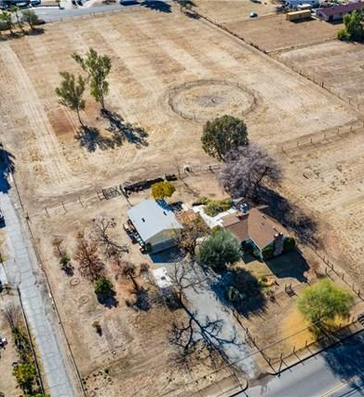
Affirmatively Furthering Fair Housing (AFFH)
Fair and equitable distribution of housing throughout the community
Protects against communities being overburdened
Considers:
A variety of housing types (single-family house, apartment, townhome, etc.)
Mix of affordability levels
Access to transportation and employment
Considers access to public transit and community resources

Slide 13
Community Engagement

Slide 14

Summary of Engagement Efforts
Completed Outreach:
Housing Element Update Webpage on the City’s website
Virtual community workshop
Recordings are available on the webpage
Email outreach to local stakeholders
Spanish translation available for all materials and presentations
Online engagement - social media and City’s website

Slide 15
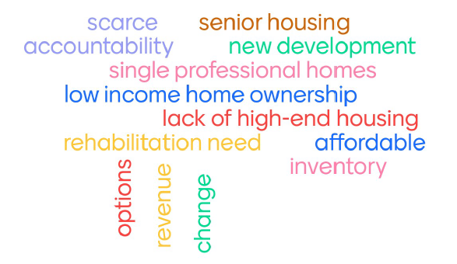
Virtual Community Workshop
Date: April 29, 2021
Spanish translation available
Overview:
Housing Element Update Process
Baseline demographics and housing data
Participant activities
Feedback received:
Imbalance of jobs and housing
Need for multi-generational and senior housing
High cost of development
Downtown revitalization needed
Mixed-use housing is a solution to jobs and revitalization

Slide 16
Tentative Upcoming Engagement Opportunities
Workshop #1
(April 29, 2021)
Planning Commission & City Council Study Session
(July 2021)
Workshop #2
(August 2021)
Public Review Draft
(August 2021)
Public Hearings
(October 2021)

Slide 17
Community Profile

Slide 18
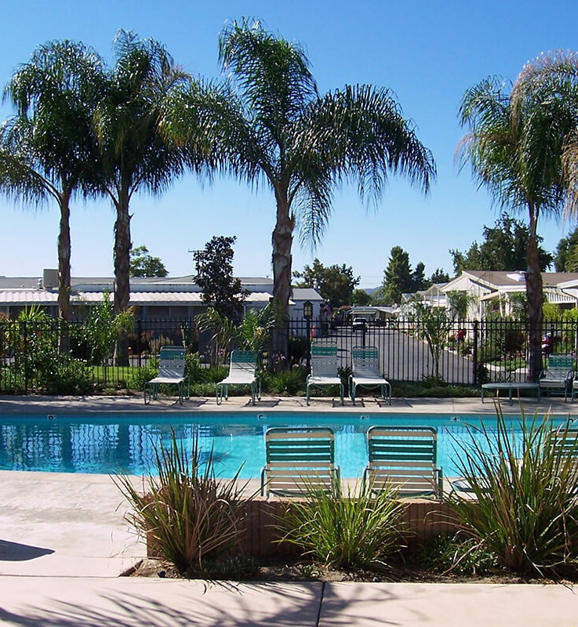
Community Profile
Describes:
Current community demographics
Economic characteristics
Housing characteristics
Data comes from U.S. Census projection data
Informs programs and policies within the Housing Element

Slide 19
The Hemet Community – Population Growth
Estimated and Projected Hemet Population (2010-2040)
Source: American Community Survey, 5-Year Estimates, 2010 / 2016-2040 RTP/SCS Final Growth Forecast

Slide 20
The Hemet Community – Race and Ethnicity
Source: American Community Survey, 5-Year Estimates, 2019

Slide 21
The Hemet Community– Household Characteristics
Household Characteristics
Household Tenure
Source: American Community Survey, 5-Year Estimates, 2019

Slide 22
Housing in Hemet – Housing Types
Source: American Community Survey, 5-Year Estimates, 2019

Slide 23
Housing in Hemet – Housing Stock
Housing Stock by Year Built
Source: American Community Survey, 5-Year Estimates, 2019

Slide 24
Sites Inventory Analysis

Slide 25
Site Selection Requirements
Requirements:
Identification of sites
Sites to accommodate low and very low-income RHNA
Capacity analysis
Nonvacant sites
Determination of adequate sites
Inventory of sites must include:
APNs
Parcel size
General Plan/Zoning designations
Existing use
Whether publicly owned or lease
Number of units to accommodate
Availability of accessible infrastructure
RHNA income category
Whether identified in past Cycles

Slide 26
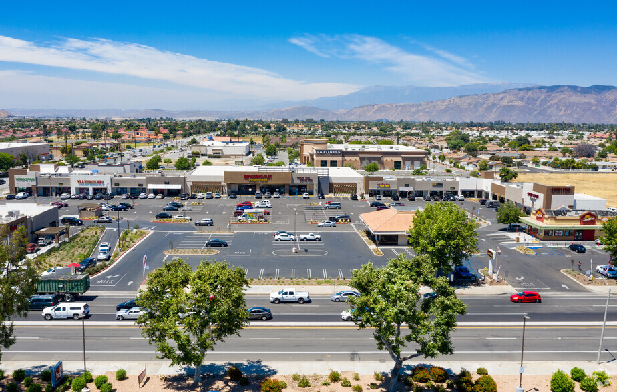
Sites Selection Process
Site selection criteria:
Vacant sites
Underutilized parcels
Existing residential sites capable of developing at higher density
City-owned properties
Existing non-residential sites capable of rezoning for residential use
Consider the existing use and its realistic likelihood to redevelop for residential uses within the planning period.

Slide 27
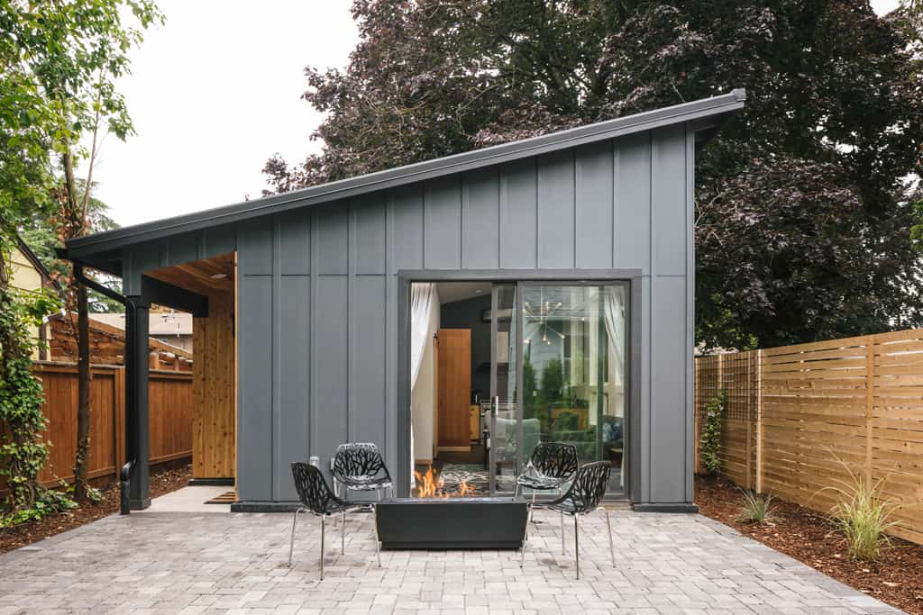
Potential Strategies
Existing residentially-zoned vacant properties
Non-residentially zoned vacant properties
In-the-Pipeline Projects
Specific Plan capacity
Accessory Dwelling Unit (ADU) Production
Estimated: 20 units over 8 years

Slide 28
Next Steps

Slide 29
Next Steps
Finalize Housing Constraints, Resources, Sites Analysis, and Housing Plan
Workshop #2
Release Public Review Draft Housing Element
Review Public Feedback
HCD Review Draft Housing Element
Local Adoption of the Housing Element

Slide 30
Thank you!
Monique Alaniz-Flejter, Principal Planner
Email: mflejter@hemetca.gov
Phone: (951) 765-2370
For more information, please visit the City’s Housing Element Update webpage:
www.hemetca.gov/1029/Housing-Element-Update

