Slide 1

Regional Economic Outlook and Trends for Hemet/San Jacinto
Daniel MacDonald, PhD
Inland Empire Dynamic Insights
www.iedynamicinsights.com
March 20, 2025

Slide 2
Overview
U.S. outlook
Solid GDP and labor force growth expected to continue
Interest rates, inflation, and uncertainty remain risks
AI and WFH trends
California and Riverside County
Solid GDP, labor force, and job growth
Interest rates, inflation are short-term risks (real estate)
Migration patterns are a longer-term risk
Hemet + San Jacinto
Region has grown tremendously: capacity, opportunity, amenities
Economic outcomes
Real estate market

Slide 3
Overview
U.S. outlook
Solid GDP and labor force growth expected to continue
Interest rates, inflation, and uncertainty remain risks
AI and WFH trends
California and Riverside County
Solid GDP, labor force, and job growth
Interest rates, inflation are short-term risks (real estate)
Migration patterns are a longer-term risk
Hemet + San Jacinto
Region has grown tremendously: capacity, opportunity, amenities
Economic outcomes
Real estate market

Slide 4
US Outlook
GDP growth has been solid for past few years and forecasted to be steady in 2025
Unemployment remains low, very slightly up from year ago
Inflation still elevated, remains a concern (re: interest rates)
Interest rates continue to affect consumption, household debt

Slide 5
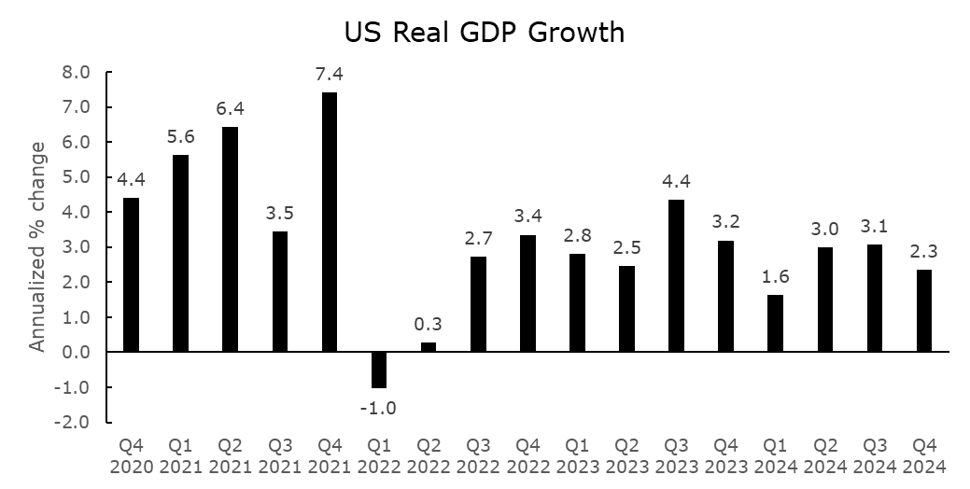

Slide 6
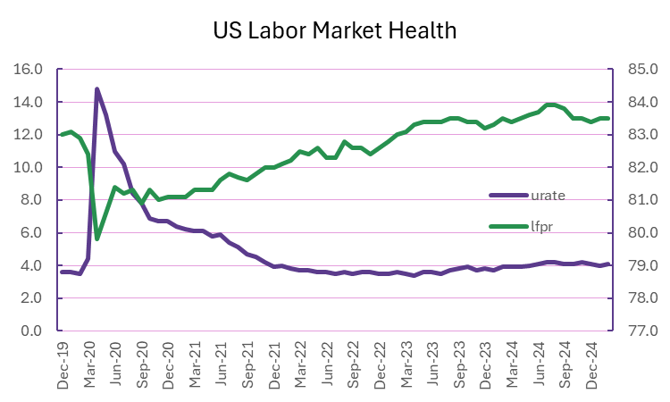

Slide 7
Overview
U.S. outlook
Solid GDP and labor force growth expected to continue
Interest rates, inflation, and uncertainty remain risks
AI and WFH trends
California and Riverside County
Solid GDP, labor force, and job growth
Interest rates, inflation are short-term risks (real estate)
Migration patterns are a longer-term risk
Hemet + San Jacinto
Region has grown tremendously: capacity, opportunity, amenities
Economic outcomes
Real estate market

Slide 8
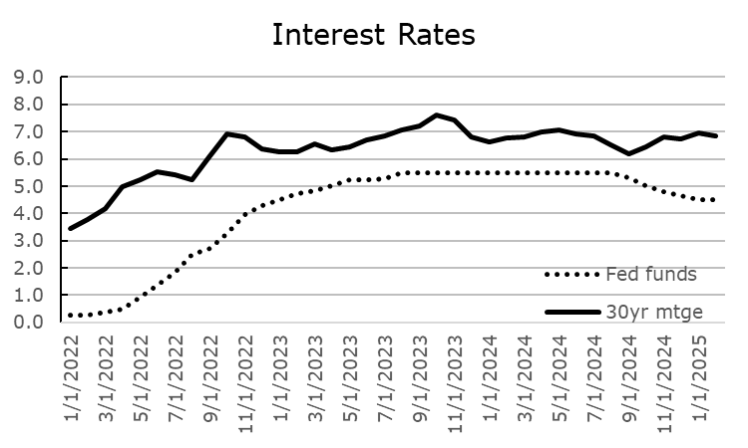

Slide 9
Econ 201, Lesson 1
The Fed has less of a control over interest rates than you think
This year, interest rates will be determined by…
Inflation expectations
Assessment of future economic health
Level of uncertainty
Fewer rate cuts than previously expected

Slide 10
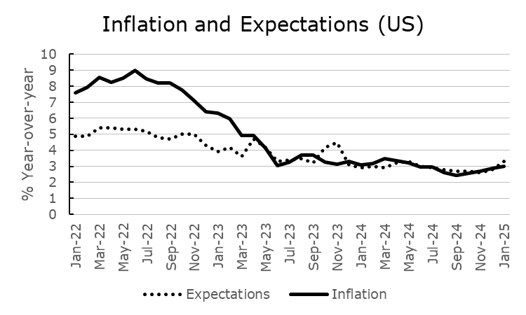

Slide 11
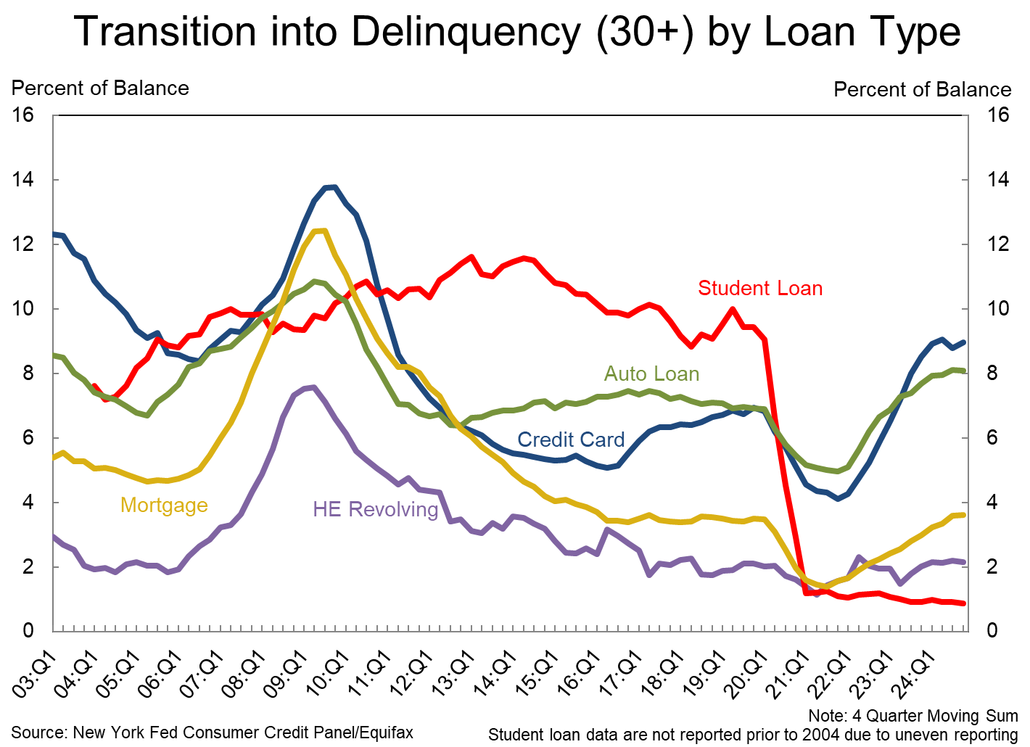

Slide 12
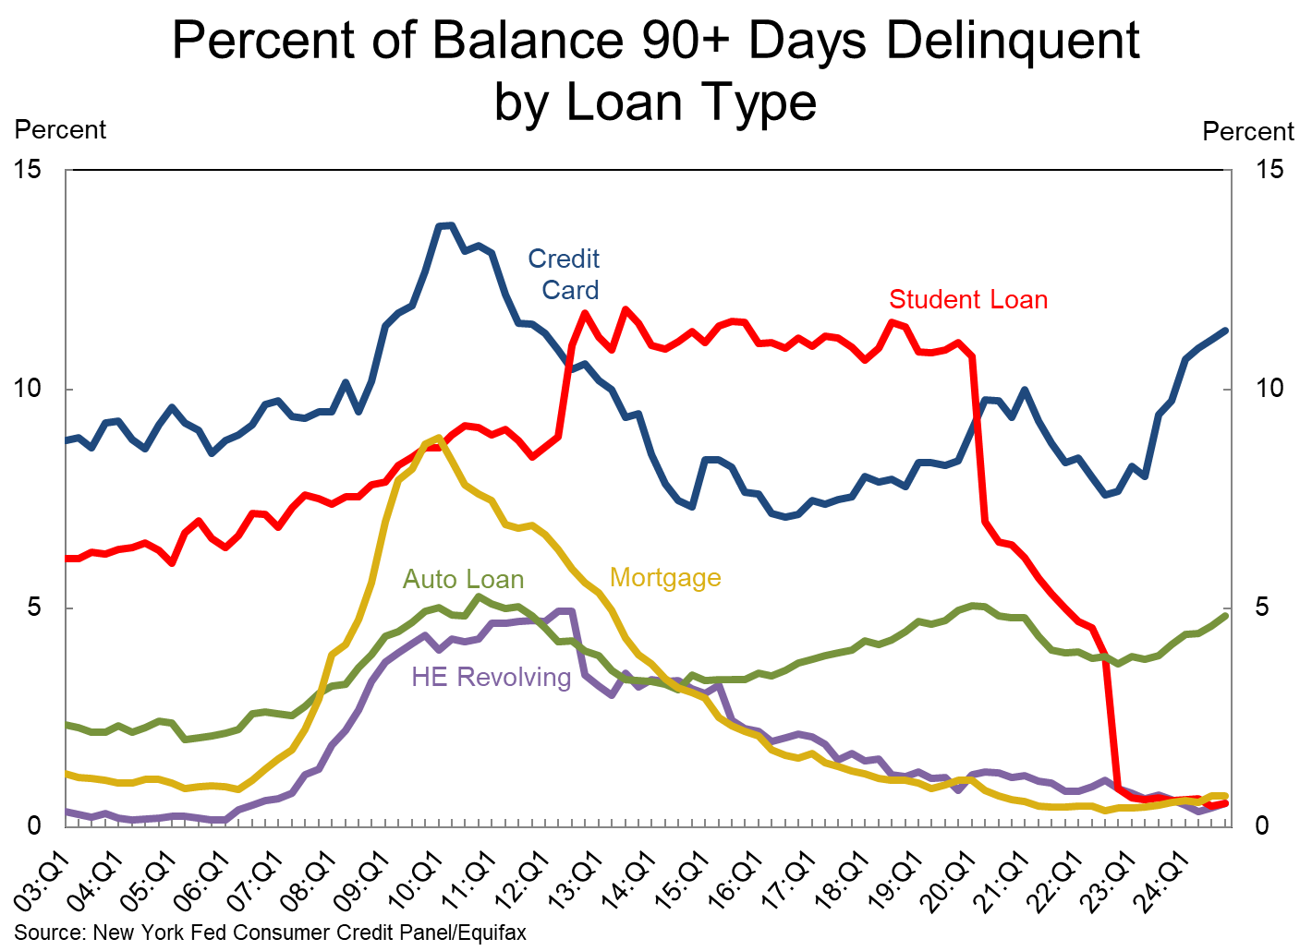

Slide 13
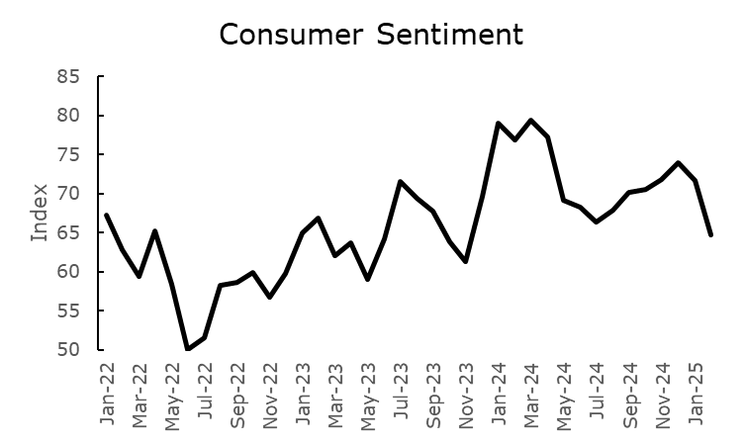

Slide 14
Overview
U.S. outlook
Solid GDP and labor force growth expected to continue
Interest rates, inflation, and uncertainty remain risks
AI and WFH trends
California and Riverside County
Solid GDP, labor force, and job growth
Interest rates, inflation are short-term risks (real estate)
Migration patterns are a longer-term risk
Hemet + San Jacinto
Region has grown tremendously: capacity, opportunity, amenities
Economic outcomes
Real estate market

Slide 15
Source: https://www.wfhresearch.com

Slide 16
Overview
U.S. outlook
Solid GDP and labor force growth expected to continue
Interest rates, inflation, and uncertainty remain risks
AI and WFH trends
California and Riverside County
Solid GDP, labor force, and job growth
Interest rates, inflation are short-term risks (real estate)
Migration patterns are a longer-term risk
Hemet + San Jacinto
Region has grown tremendously: capacity, opportunity, amenities
Economic outcomes
Real estate market

Slide 17
CA and Riverside County Outlook
Like rest of U.S., growth is in solid shape, expected to continue
Major job growth in high and middle-income sectors
Short-term: Inflation and interest rates remain risks to consumption, housing market
Longer-term: Migration trends may reduce labor force growth
Less of a concern in Riverside County than in San Bernardino

Slide 18
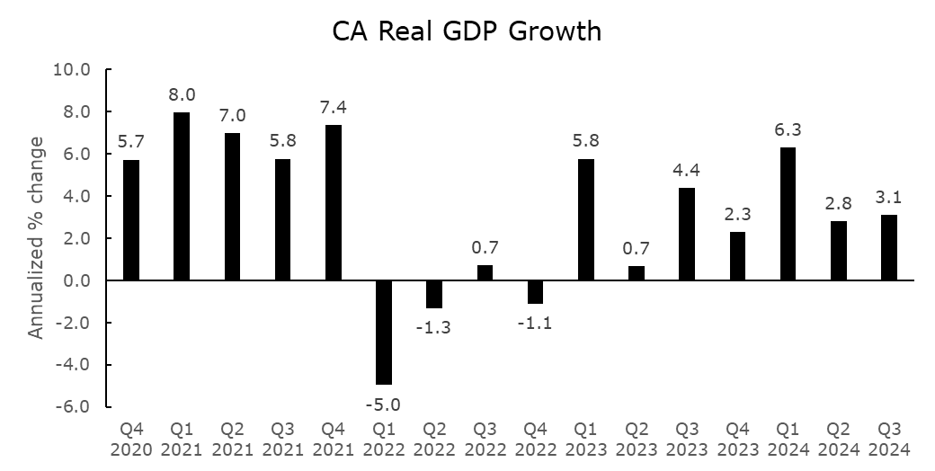

Slide 19
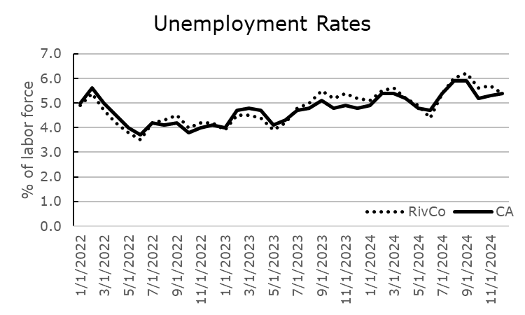

Slide 20
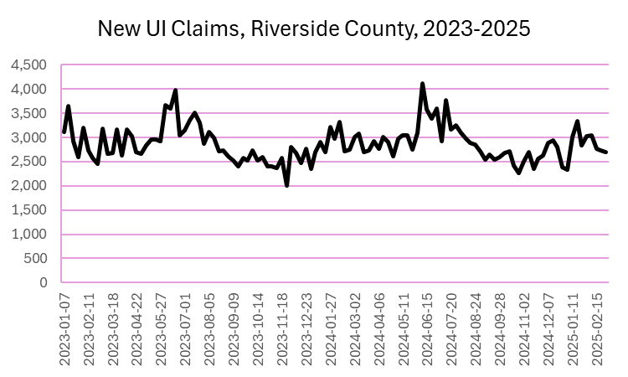

Slide 21
 | Job Counts, Riverside County
 | Q3-2019 | Q3-2024 | Change
Federal government | 7,472 | 7,808 | 336
State government | 12,528 | 13,167 | 639
Local government | 111,422 | 119,596 | 8,174
Natural Resources + Mining | 11,122 | 10,848 | -274
Construction | 70,763 | 73,957 | 3,194
Manufacturing | 45,189 | 44,084 | -1,105
Trade, Transportation, Utilities | 167,925 | 195,448 | 27,523
Information | 0 | 5,667 | 5,667
Financial Activities | 21,484 | 20,577 | -907
Professional + Business Services | 74,469 | 76,063 | 1,594
Education + Health Services | 113,372 | 143,225 | 29,853
Leisure and Hospitality | 94,777 | 100,606 | 5,829
Other services | 20,475 | 23,375 | 2,900
Total | 757,444 | 834,874 | 77,430

Slide 22
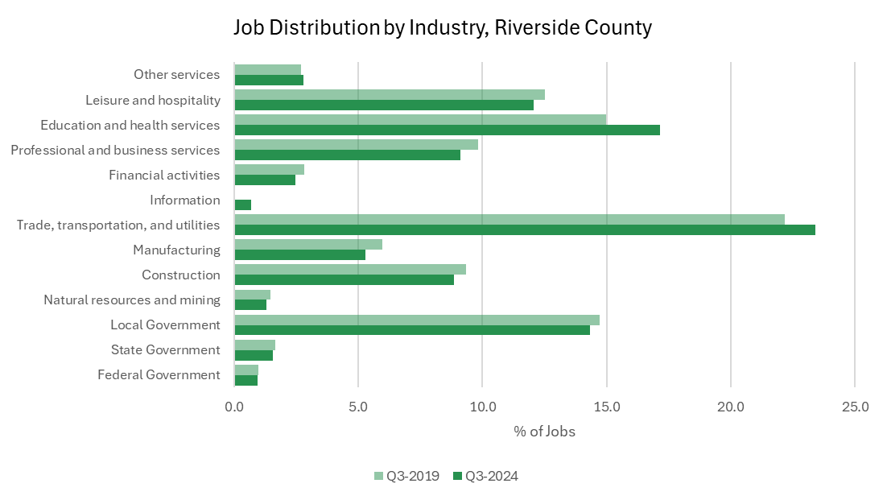

Slide 23
How We Compare
Out of counties with over 100,000 jobs, Riverside County #3 in job growth from Q3 2023 to 2024 (+1.8%)
Behind Sacramento (2.3%) and tied with Fresno
RivCo 4.3% population growth between 2020 and 2025; 7th largest in state, one of only 15 counties to experience growth, and 1st highest growth rate for counties above 1 million people
10th largest increase in education and health services employment and 1st largest among counties employing over 100,000 in that industry

Slide 24
Overview
U.S. outlook
Solid GDP and labor force growth expected to continue
Interest rates, inflation, and uncertainty remain risks
AI and WFH trends
California and Riverside County
Solid GDP, labor force, and job growth
Interest rates, inflation are short-term risks (real estate)
Migration patterns are a longer-term risk
Hemet + San Jacinto
Region has grown tremendously: capacity, opportunity, amenities
Economic outcomes
Real estate market

Slide 25
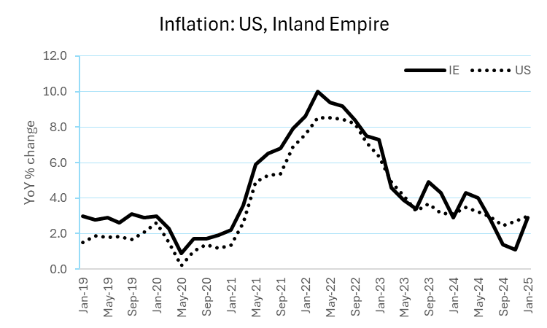

Slide 26
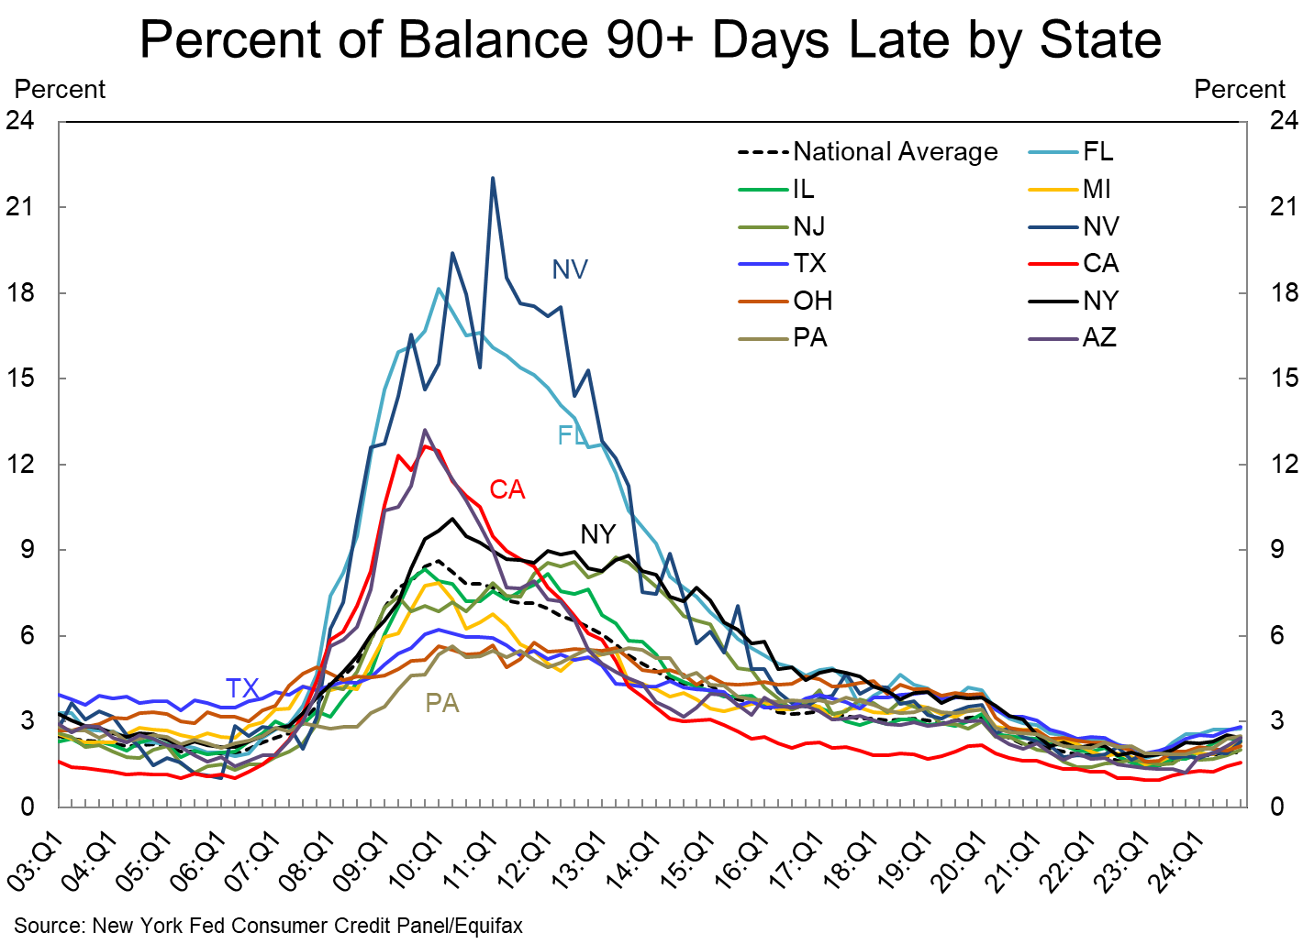

Slide 27
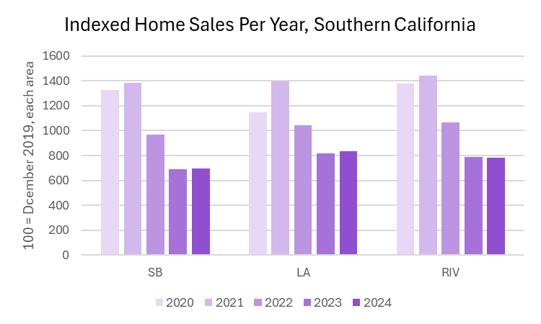

Slide 28
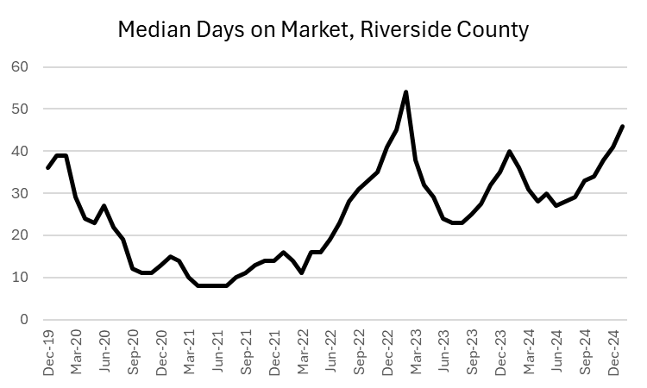

Slide 29

Econ 201, Lesson 2
“Soft landing”?
The economy is not an airplane!
Real forces (inflation, economic outlook, jobs, income) will drive growth/real estate down, or push it up
We are the economy – recessions don’t define us; we define our path during “bad weather”

Slide 30
Overview
U.S. outlook
Solid GDP and labor force growth expected to continue
Interest rates, inflation, and uncertainty remain risks
AI and WFH trends
California and Riverside County
Solid GDP, labor force, and job growth
Interest rates, inflation are short-term risks (real estate)
Migration patterns are a longer-term risk
Hemet + San Jacinto
Region has grown tremendously: capacity, opportunity, amenities
Economic outcomes
Real estate market

Slide 31
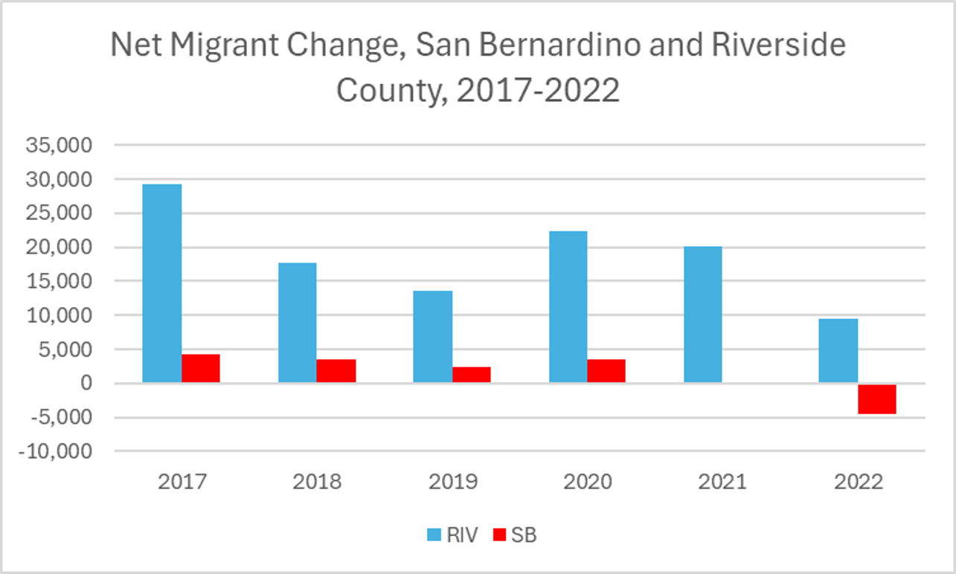

Slide 32
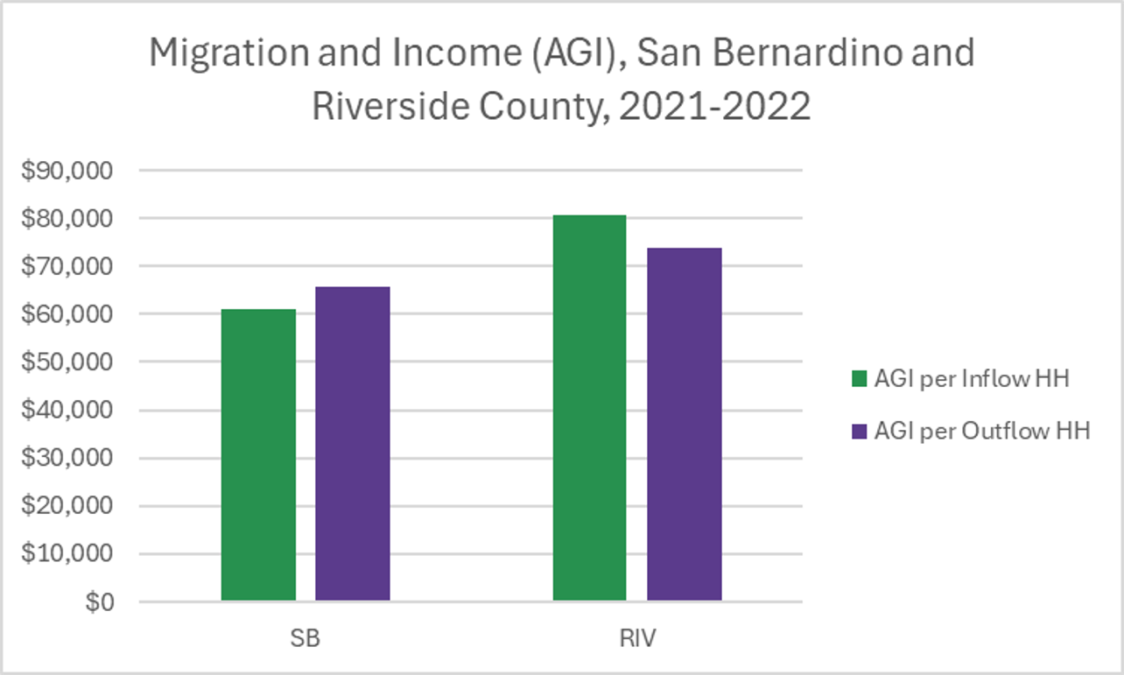

Slide 33
Overview
U.S. outlook
Solid GDP and labor force growth expected to continue
Interest rates, inflation, and uncertainty remain risks
AI and WFH trends
California and Riverside County
Solid GDP, labor force, and job growth
Interest rates, inflation are short-term risks (real estate)
Migration patterns are a longer-term risk
Hemet + San Jacinto
Region has grown tremendously: capacity, opportunity, amenities
Economic outcomes
Real estate market

Slide 34

Hemet/San Jacinto Outlook
Region has grown tremendously over past few years (population, workforce, housing)
Homeownership rates are up, but so are owner and rental costs
Region shifting into higher-income jobs
Despite high interest rates, real estate market remains healthy

Slide 35
Econ 201, Lesson 3: How economies grow
Capacity
Population/workforce size, age
Education
Infrastructure
Environment
Opportunity
Industries (growth, mix)
Income and jobs
Cost of living
Homeownership
Amenities
Schools
Commuting/WFH
Culture/Entertainment

Slide 36
 | Hemet | Rank¹ | Notes
% 16 and older | 79.3 | Tied-4th highest | Hemet/SJ has a large working-age population
Change from 2018 | 0.6 p.p. | 9th highest
Total population | 92,385 | 9th highest | Hemet/SJ are smaller cities in Riverside County, but growing rapidly
Change from 2018 | 8.3% | 2nd highest
Median age | 38.9 | 11th lowest | Hemet/SJ population older than average, but is getting younger, unlike many other cities
Change from 2018 | -1.5 years | 2nd lowest
¹: Based on 12 major cities in Riverside County: Corona, Eastvale, Hemet, Indio, Jurupa Valley, Lake Elsinore, Menifee, Moreno Valley, Murrieta, Perris, Riverside (City), Temecula

Slide 37
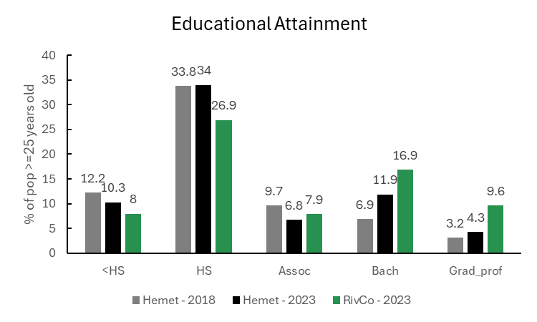

Slide 38
 | Hemet, 2018 | Hemet, 2023 | Change | Riverside County, 2023
Median income – Less than HS | $35,686 | $32,094 | -10.1% | $33,941
Median income – HS | $30,057 | $41,296 | 37.4% | $41,393
Median income – Assoc | $26,413 | $46,146 | 74.7% | $48,834
Median income – Bach | $37,647 | $51,976 | 38.1% | $69,262
Median income – Grad or Professional | $70,884 | $95,716 | 35.0% | $90,928

Slide 39
Overview
U.S. outlook
Solid GDP and labor force growth expected to continue
Interest rates, inflation, and uncertainty remain risks
AI and WFH trends
California and Riverside County
Solid GDP, labor force, and job growth
Interest rates, inflation are short-term risks (real estate)
Migration patterns are a longer-term risk
Hemet + San Jacinto
Region has grown tremendously: capacity, opportunity, amenities
Economic outcomes
Real estate market

Slide 40
 | Hemet, 2018 | Hemet, 2023 | Change | Riverside County, 2023
Homeownership Rate | 60.5% | 64% | 3.5 p.p. | 69.1%
Overcrowding Rate | 3.0% | 10.3% | 7.3 p.p. | 8.5%
Median owner costs | $1,323 | $2,113 | +59.7% | $2,486
Median rental costs | $1,138 | $1,617 | +42.1% | $1,871
Median home value | $196,700 | $370,200 | +88.2% | $576,000

Slide 41
 | 2018 | 2023 | Change
Finance, insurance, real estate | 2.5% | 5.0% | +2.5 p.p.
Prof., Scientific, Mgmt. Services | 11.4% | 13.2% | +2.8 p.p.
Information | 1.0% | 0.8% | -0.2 p.p.
Public administration | 3.9% | 5.6% | +1.7 p.p.
Educ., health, social services | 22.8% | 18.3% | -4.5 p.p.
Construction | 8.2% | 14.7% | +6.5 p.p.
Manufacturing | 6.1% | 7.4% | +1.3 p.p.
Wholesale trade | 3.6% | 1.2% | -2.4 p.p.
Trans., warehouse, utilities | 7.1% | 7.0% | -0.1 p.p.
Retail | 14.1% | 11.4% | -2.7 p.p.
Other services | 4.7% | 2.0% | -2.7 p.p.
Arts and Entertainment | 14.0% | 11.8% | -2.2 p.p.
Total employed | 29,247 | 34,630 | 18.4%
Industrial distribution

Slide 42
Occupational distribution
 | Hemet, 2023 | Riverside County, 2023
Management | 28.8% | 34.7%
Sales and office | 21.1% | 19.7%
Prod., Trans., Material Moving | 13.5% | 15.0%
Nat. resources + Construction | 13.8% | 10.6%
Services | 22.8% | 20.0%
Total employed | 34,630 | 1,154,432

Slide 43
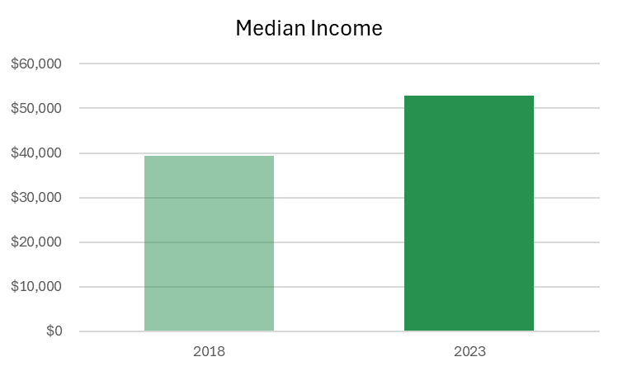

Slide 44
Overview
U.S. outlook
Solid GDP and labor force growth expected to continue
Interest rates, inflation, and uncertainty remain risks
AI and WFH trends
California and Riverside County
Solid GDP, labor force, and job growth
Interest rates, inflation are short-term risks (real estate)
Migration patterns are a longer-term risk
Hemet + San Jacinto
Region has grown tremendously: capacity, opportunity, amenities
Economic outcomes
Real estate market

Slide 45
Real Estate
Hemet/SJ real estate is following many county-level trends:
Higher prices, but…
More time on market before sale
More inventory
Much of this driven by interest rate environment
Experts forecast that the rental market will have a good year as affordability continues to erode and the job market remains healthy
Because of its relative affordability, Hemet/SJ market will continue to attract buyers – analytics can help us identify “hotter” zips

Slide 46
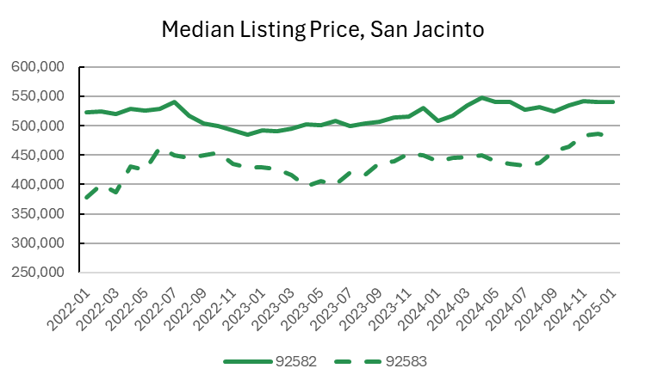
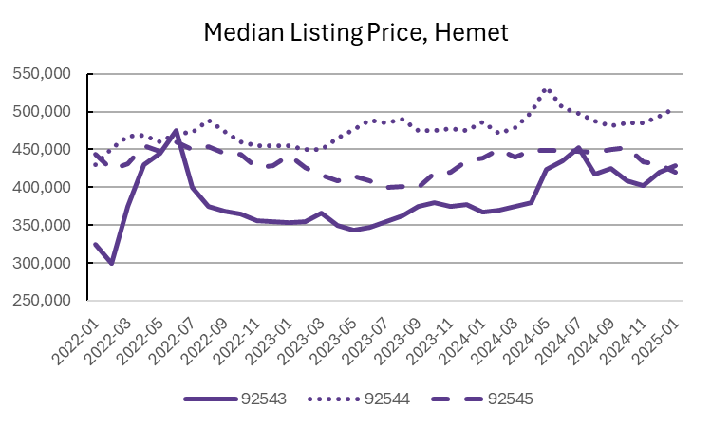

Slide 47
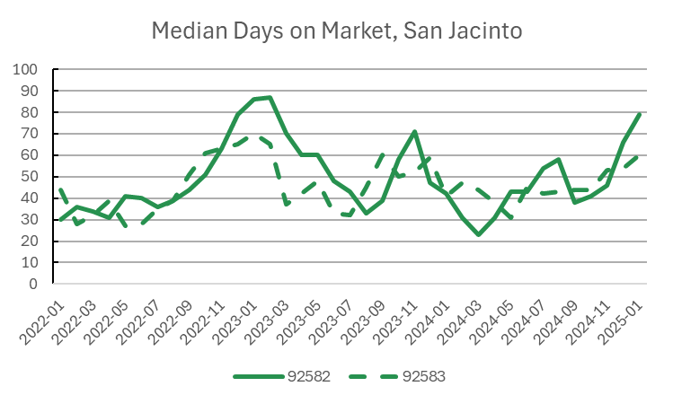
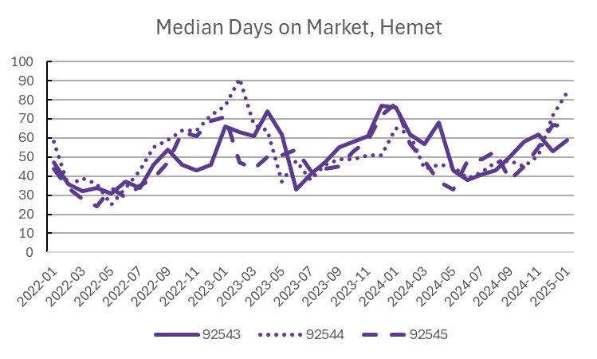

Slide 48
Thank you
Inland Empire Dynamic Insights provides data consulting services to a variety of stakeholders
Let us help you understand how your community has changed and how you can achieve your vision for where it’s headed
Equipped with over a decade of experience in applied economic research, we leverage the latest tools to solve your problems:
Python/Tableau for data/visualization
The latest research in regional science/urban planning
Deep understanding of local, regional, and national economic trends
Learn more at www.iedynamicinsights.com

Slide 49
Sources
Bureau of Economic Analysis, National and Regional Data on Real GDP: https://www.bea.gov/itable
Bureau of Labor Statistics: https://www.bls.gov/
American Community Survey 1-year estimates: https://data.census.gov/
Jobs by industry data, QCEW: https://www.bls.gov/cew/downloadable-data-files.htm
New York Federal Reserve, Quarterly Report on Household Debt and Credit: https://www.newyorkfed.org/data-and-statistics
Working from home statistics: https://wfhresearch.com/
Median listing price, active listing count, and median days on market: https://www.realtor.com/research/data/

